Slide 1



Slide 2






Vue Introduction
Vue is:
Performant progressive javascript framework for building user interface
Helps you create a more maintainable and testable codebase
Designed to be incrementally adoptable
Easy integration with other libraries or existing projects
Capable of powering Single-Page Applications when used in combination with modern tooling and supporting libraries (Vue-Router, Vuex, …)
Vue Introduction

Slide 3
Vue Pros
Vue Pros
Small Size (18 KB after gzipping)
Ease of understanding and development
Simple Integration
Comprehensive documentation
Flexibility
Reactivity
Powerfull CLI
TypeScript Support
Browser devtools extensions

Slide 4
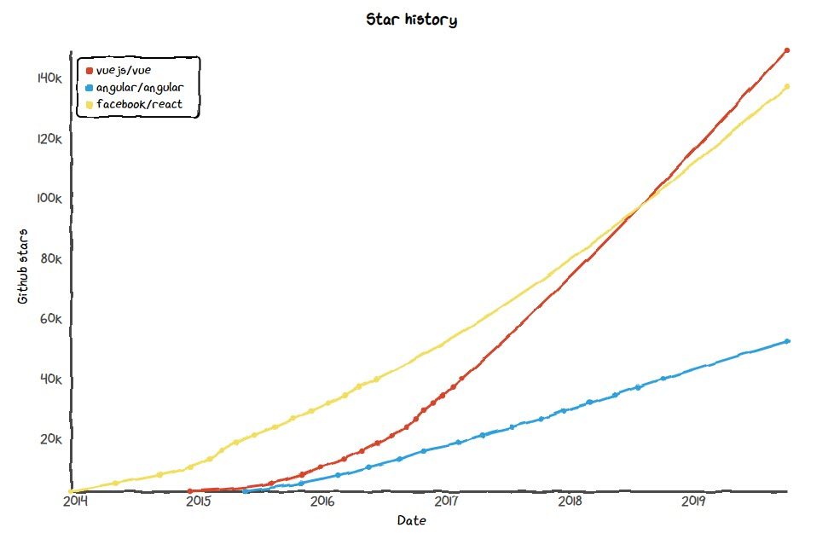
Vue Popularity
Fast Growing Github Stars

